Slide 1
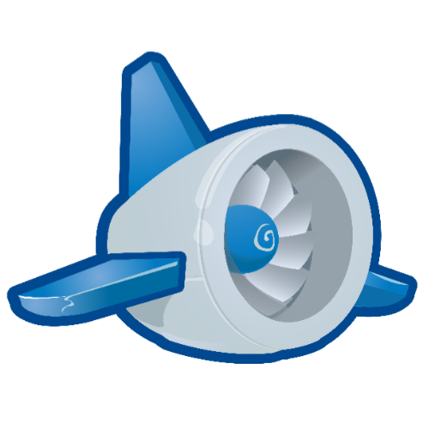
Google App Engine Tutorial
Joe Gregorio
Developer Advocate
Google App Engine
Joe Gregorio
Developer Advocate
Google App Engine

Slide 2
Logging
  Logging and the Dashboard

Slide 3
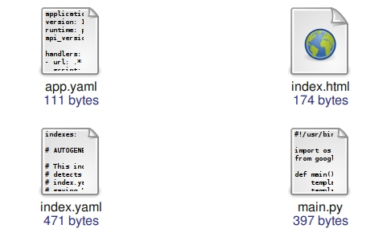
The contents of tutorial9

Slide 4
Add logging to main.py
import logging
...
def post(self):
description = self.request.get("description")
todo = ToDoModel(description = description)
todo.put()
def txn():
count = ItemCount.get_by_key_name("created_items")
count.total += 1
count.put()
logging.info("Count = %d" % count.total)
db.run_in_transaction(txn)
self.redirect("/")

Slide 5
Add logging to main.py
INFO 2009...,443 __init__.py] Count = 4
INFO 2009...,450 __init__.py] "POST / HTTP/1.1" 302 -
INFO 2009...,468 __init__.py] "GET / HTTP/1.1" 200 -

Slide 6
Practice
logging.debug
logging.warning
logging.error
logging.debug(count)

Slide 7
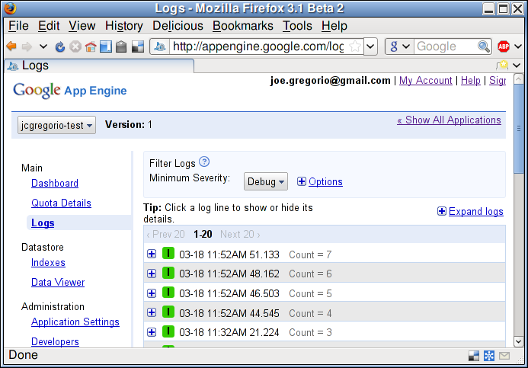
Dashboard

Slide 8
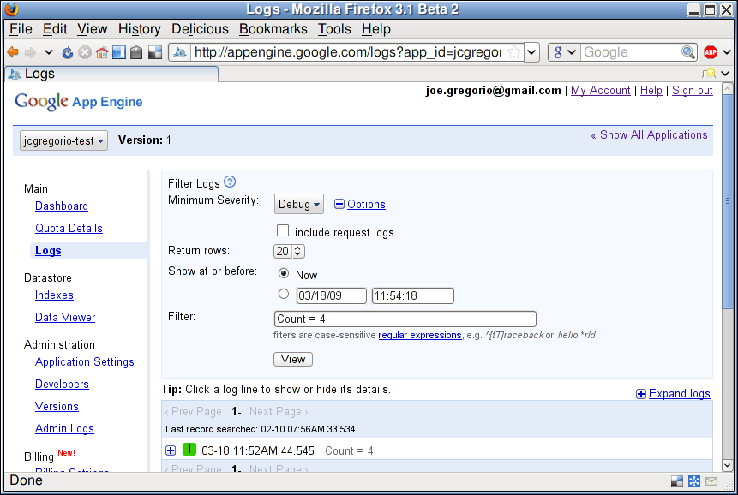
Filtering

Slide 9
Getting the logs
$ ../appcfg.py request_logs --severity=0 . -
Downloading request logs for jcgregorio-test 1.1.
Copying request logs to '-'.
[18/Mar/2009:11:32:21 -0700] "POST / HTTP/1.1" 302 151 "http://jcgregorio-test.appspot.com/" -
1:1237401141.224716 Count = 3
[18/Mar/2009:11:52:44 -0700] "POST / HTTP/1.1" 302 151 "http://jcgregorio-test.appspot.com/" -
1:1237402364.545833 Count = 4
...

Slide 10
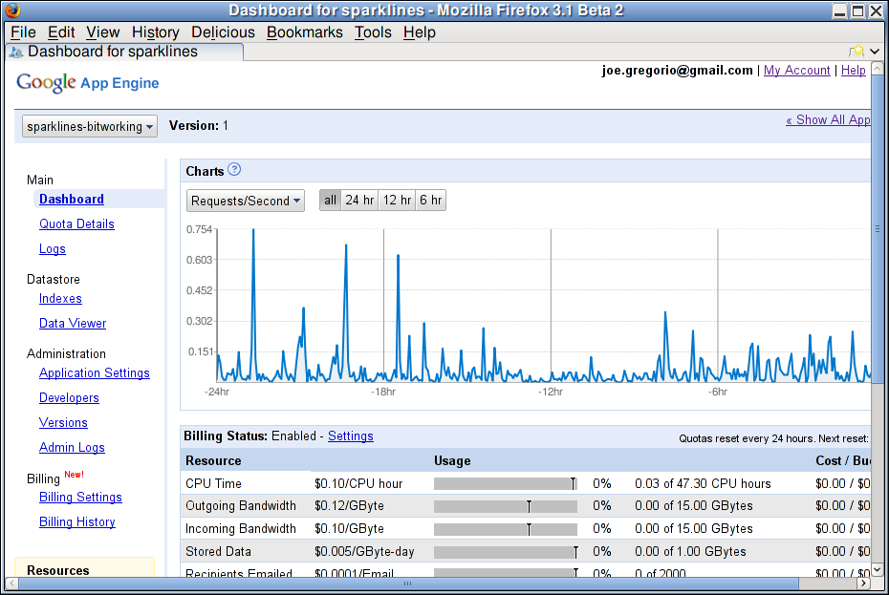
A tour of the rest of the Dashboard

Slide 11
Thank You
  Questions?

